Slide 1
GRANT SABTIER'S
FINANCIAL FREEDOM
A proven path to all the money you ever need

Slide 2

About
The Book
The book "Financial Freedom", released in 2019, was written by Grant Sabatier.
This book tells how Sabatier managed, over 5 years, to leave $ 2.65 and accumulate $ 1.25 million and still become a specialist in finance. It will give you the first steps to achieving financial freedom
At age 22, Grant Sabatier held a job in the call center market. The salary was enough to cover his expenses and save a little at the end of the month. However, he did not spare a penny. "I chose not to think about it and live my life," says Sabatier.

Slide 3




Main Ideas
Time is Freedom
Make a Plan and reduce monthly expenses
Understand the true cost and find what you value most
Find ways to make more money to invest
Saving money should be a daily goal

Slide 4

Chapter 1
MONEY IS FREEDOM
Doing everything I was “supposed” to do wouldn’t guarantee anything.
Levels of financial freedom:
Clarity
Self Sufficiency
Breathing room
Stability
Flexibility
Financial independence
Abundant wealth

Slide 5

Chapter 2
TIME IS MORE VALUABLE THAN MONEY
Money is unlimited. Time is not. Don’t waste time.
The key to fast-tracking financial freedom is making and investing as much money as early and frequently as you can.
The relationship between money and time is not strictly linear: if you want to make more money, you don’t necessarily need to sacrifice more time to do so.

Slide 6

Chapter 3
WHAT IS YOUR NUMBER???
"How much money do you spend? How much money do you need for the rest of your life? How much money should you save on a daily, weekly, monthly and yearly basis?"
Personal finance is personal. So, there are no lifestyles alike and it s very important to know your numbers, but that are probably smaller than you think.

Slide 7
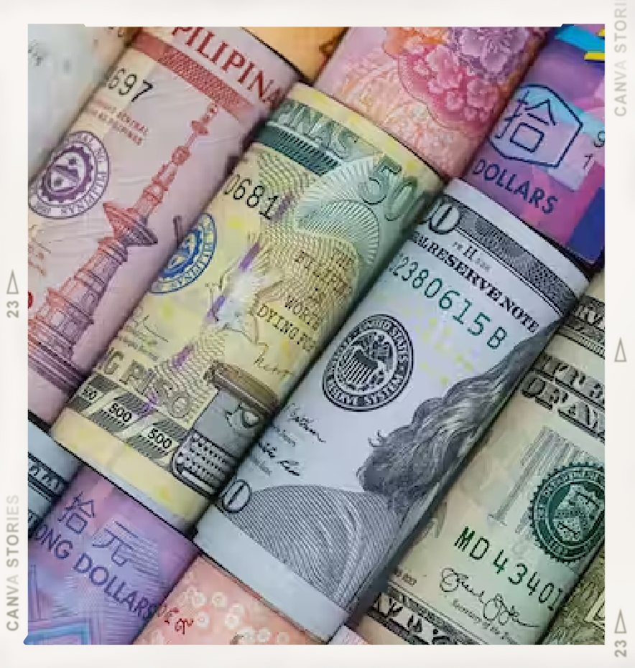
Chapter 4
WHERE ARE YOU NOW???
Net worth is the most important number in personal finance and is your financial scorecard. Your net worth is not the same as your number.
People get too emotional about money.
Daily habits equal riches. Happiness is in the journey, the challenge, the growth.
Spend five minutes a day with your money.

Slide 8

Chapter 5
NEXT- LEVEL MONEY
Building wealth relies on the same three basic levers- Income, Savings and Expenses
Your savings rate is directly correlated with the amount of time it will take you to hit your number.
To make as much money as possible, you want to combine and maximize as many moneymaking strategies as possible.
Find a side hustle

Slide 9
Chapter 6
How happy will this purchase make me?
How much money do I have to make to afford this?
How many hours of my life am I trading to afford this?
Can I afford it?
How do prices compare in terms of percentages?
Can I get it for less or trade for it?
IS IT WORTH IT????
Saving money is making money.
The higher your real hourly rate, the more money you are making for your time.
How much am I spending on convenience?
How much would this cost me each year or for the rest of my life?
What is the per-use cost of this item?
How much will this money be worth in the future?
How much time (freedom) is this buying me in the future?
Your nine-to-five job takes a lot more of your time and your life than you realize.

Slide 10
THE ONLY BUDGET YOU NEED
Chapter 7
01
You don’t need to budget.
03
Transportation
You can likely save at least 20 percent or more per month by cutting back on your three biggest expenses—housing, transportation, and food.
Save on transportation by walking and biking whenever possible. If you don’t really need a car, then don’t buy one. If you do have to have one, always buy used. Get out and explore the world. It’s never been easier to travel for less.
Food
02
Housing
04
Save on your housing by moving to a cheaper home or renting out your extra rooms or entire home. Other options are living for free by house-sitting or buying a home and house-hacking.
Save money on food by growing your own, cooking at home, buying in bulk, bartering with your neighbors, and hunting promos

Slide 11

Chapter 8
OPTIMIZE YOUR 9- TO-5
Your full-time job is an incredible income opportunity and you should use it as a launching pad by maximizing your benefits and salary opportunities while building other income streams.
Maximize your benefits. Maximize your salary.
Skills are the currency of the future.

Slide 12
Indicator 1
The skill required to perform the task or your relative skill level as compared to your competitors
Chapter 9
MORE MONEY IN LESS TIME
You need to diversify your income streams by developing one or more side hustles—moneymaking ventures outside of your full-time job.
Indicator 2
Demand, added value, perceived value and how much someone is able to pay
Side hustling is great because you can make money- sometimes a lot of money doing pretty much anything.
It also typically requires very little investment to get started, and it’s easy to test multiple ideas.
Indicator 3
Focus on building a lifestyle business— knowing when and how to scale.

Slide 13
Step 1: Separate your short- term and long-term investing goals
Step 2: Figure out how much you have to invest.
Step 3: Determine your target asset allocation
Step 4: Evaluate your current fees
Chapter 10
THE SEVEN-STEP FAST-TRACK INVESTMENT STRATEGY
This strategy is built on five key concepts you can directly influence:
Step 5: Pick the right investments.
Step 7: accounts
Invest in taxable
Minimizing risk
Minimizing fees
Minimizing taxes contributions
Step 6: Max out your tax- advantaged accounts.
Never invest in anything you don’t understand.
on your
Maximizing returns
Minimizing taxes withdrawals
on your

Slide 14
Develop real estate investing criteria to follow.
Chapter 11
REAL ESTATE INVESTING
There are three primary ways to invest in real estate:
You can buy and sell (aka flip) properties;
You can buy, sell, and trade up into a nicer home; or
You can buy and hold for the long term.
Set a budget and get preapproved for a mortgage or loan.
Look for properties that generate immediate positive cash flow and have high rent and appreciation potential.
Find an amazing Realtor who does the hard work for you.
Hunt when everyone else isn’t. Look for foreclosures or short sales Test-drive the neighborhood.
Find an experienced home inspector.
Be prepared to walk away from a deal.

Slide 15

Chapter 12
MORE THAN ENOUGH
Once you are ready to retire, you’ll need to develop the right investment withdrawal strategy to ensure your money will last as long as possible.
Live off your side or passive income as long as you can. Make the most of your tax deductions. Withdraw money from your taxable accounts first.
Freedom is immense and uncertain. And life is infinitely rich when you open up to it.

Slide 16




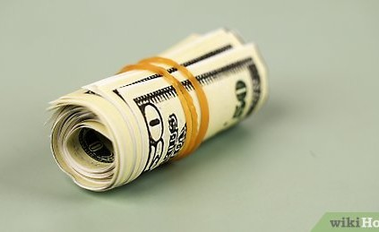
Chapter 13
THE FUTURE-OPTIMIZATION
FRAMEWORK
While you’ve learned the strategies to make early retirement possible, they are worthless unless you put them into practice.
This is your starting point. You’ll look back on this in one year and be amazed at how far you’ve come.
Focus intensely and learn to say no. Just as it’s never been easier to make money, it’s also never been easier to waste time.
Execute consistently and Know when to ask for help
Chill as hard as you hustle because Life > Money.

Slide 17




Chapter 14
LIVING A RICHER LIFE
"Financial independence is freedom to do what you want. You can have this. Making a lot of money quickly is possible. Having more time is possible. Living life on your own terms is possible. You have a unique opportunity that many do not have. You really can have all the money you need."

Slide 18
THANKS FOR WATCHING

